Slide 1
ECEN 350 Electronic Devices and Circuits
pn Junction Diodes

Slide 2
ECEN 350 – Topics
Semiconductor Physics
IC Op-Amps
Rectifiers
Zeners
Diodes
BJTs
MOSFETs
CMOS
LEDs
Transistor Biasing
Small-Signal Analysis
Amplifier Gain Stages
Frequency Response

Slide 3
Bohr Model of a Copper Atom
-
4th shell
1 electron
-
-
-
-
-
-
Nucleus:
29 Protons
29 Neutrons
-
-
-
-
-
-
-
+
+
3rd shell
2(3)² = 18 electrons
-
+
-
+
-
-
-
-
-
-
-
1st shell
2n² ⁼2(1)² = 2 electrons
-
-
-
-
-
2nd shell
2(2)² = 8 electrons
-
+
- Protons (positive charge)
- Neutrons (no electrical charge)
-
- Electrons (negative charge)

Slide 4
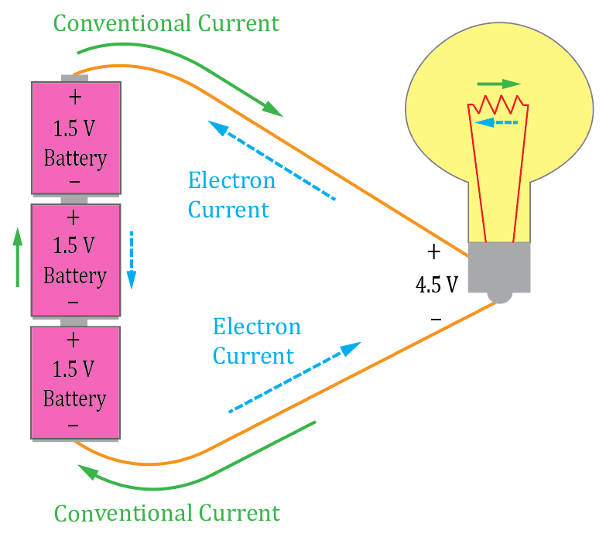
Conventional versus Electron Current Flow
In 1750 Benjamin Franklin theorized electrical current was a transfer of positive charge carriers from + to -, which became the convention, known today as conventional current flow.
However, current flow in a metal wire is due to electrons. So when
current flows in a metal wire, it is actually electrons moving from the
negative towards the positive voltage, referred to as electron current flow.
Today, conventional current (positive charge transfer from + to –)
is traditionally assumed when analyzing circuits, whereas electron current
(electrons moving from – to +) is assumed when describing the actual charge
transfer process is many electrical components including wires, resistors
and transistors.
For circuit analysis, it actually doesn’t matter if charge transfer occurs by means of positive charges moving from +
to – or negative charges moving from – to +, the voltage, resistance and power are the same either way. For circuit analysis, conventional current, is used more widely than electron current, even though as in the illustration above, the actual charge carriers are electrons moving from – to +.
Conventional current flow, as originally theorized by Benjamin Franklin, occurs in many examples in chemistry and
biology. Our circuit analysis text, along with most other circuit analysis texts illustrate current flow by means of Conventional current flow, even though in electrical circuits electron current flow occurs the most. We just live with it.

Slide 5

Conventional versus Electron Current Flow
Electronic devices like diodes and transistors use schematic symbols that indicate conventional current flow direction. Consequently, conventional current flow is most commonly used in electronics.
Almost all circuit classes use conventional current flow, realizing that at the atomic level electrons actually move in the opposite direction in metal wires and electronic devices such as diodes and transistors.
Hole flow in semiconductor diodes and transistors is considered conventional current flow, i.e,. positive charge transferred from + to -.
Conventional versus Electron Current Flow can be initially confusing, but is something that Electrical Engineers have successfully dealt with for some time.
Conventional Current Flow
Conventional Current Flow

Slide 6
Bohr Model of Silicon Atom
3rd shell: 3s, 3p, 3d.
4 electrons (8 electrons desired. A 9th electron ends up in 4th shell, i.e. conduction band.)
-
-
Nucleus:
14 Protons
14 Neutrons
-
-
-
+
+
-
-
+
-
-
+
-
1st shell:1s
2n² ⁼2(1)² = 2 total electrons
-
-
-
2nd shell: 2s, 2p
2(2)² = 8 total electrons
-
+
- Protons (positive charge)
- Neutrons (no electrical charge)
-
- Electrons (negative charge)

Slide 7
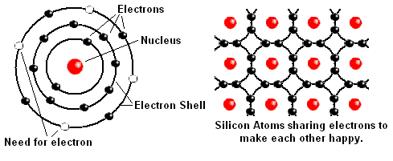
Silicon – Presently the Most Common Semiconductor Material
Silicon Crystal – 8 electrons desired in the outer shell, resulting in solid silicon having 4 covalent bonds, i.e., electron sharing, with the 4 nearest neighbors.
Intrinsic – pure. Can achieve 1 part in 10 billion for silicon. Number of electrons in the conduction band equals the number of holes in the valence band for intrinsic silicon.
In a solid a large number of closely spaced allowable electron energy states exits, forming allowable bands of energy, i.e., energy bands.

Slide 8
Electron Energy Bands
E_{g} = 1.43 eV for Gallium Arsenide
E_{g} = 1.1 eV for Silicon
E_{g} = 0.67 eV for Germanium
Increasing Electron
Energy
Conduction Band
Lowest energy un-occupied band
at T = 0 Kelvin. (Absolute Zero)
E_{C}
Energy
Bandgap
E_{g}
Valence Band
Highest energy occupied band
at T = 0 Kelvin. (Absolute Zero)
E_{V}
At T = 0 Kelvin, (Absolute Zero), semiconductors like silicon are insulators because no electrons have sufficient energy to occupy the conduction band.
There are no free electrons for conduction in a semiconductor at 0 K.

Slide 9
Electron Energy Bands (Continued)
At room temperature (293 Kelvin), intrinsic silicon has many conduction band electrons, resulting in an equal number of broken covalent bonds in the valence band.
Silicon has a negative temperature coefficient of resistance (TCR), i.e., resistance decreases for increasing temperature because of an increasing number of thermally generated charge carriers.
Increasing Electron
Energy
E_{C}
- - -
Conduction Band
Energy
Bandgap
E_{g}
E_{V}
Valence Band

Slide 10
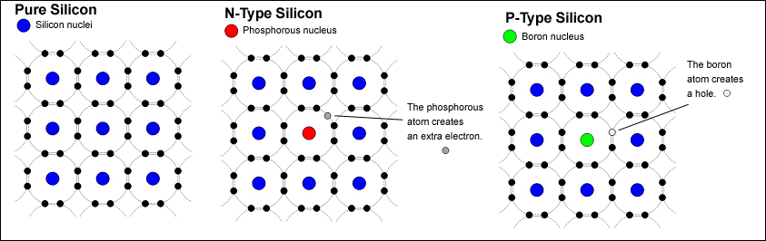
Doping of Semiconductors
n-type Silicon: Doped with Donor atoms → donate an electron (n → negative).
n- type: Electron → Majority carrier. Hole → Minority carrier.
p-type Silicon: Doped with Acceptor atoms (holes) → accept an electron (p → positive).
p-type: Hole → Majority carrier. Electron → Minority carrier.

Slide 11
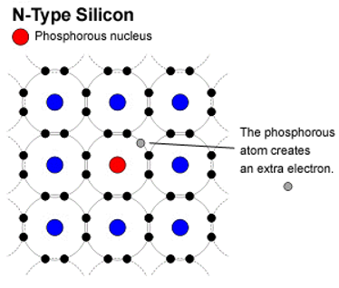
Doping of Semiconductors (Continued)
At room temperature (293 Kelvin), n-type silicon has many more conduction band electrons than valence band holes because each n-type dopant atom contributes an electron to the conduction band.
A relatively small number of valence band holes (minority carriers) in n-type silicon result from thermally generated electron-hole pairs.
Increasing Electron
Energy
n-type silicon
E_{C}
- - - - - - - - - - - - - - - - - -
Conduction Band
Energy
Bandgap
E_{g}
E_{V}
Valence Band

Slide 12
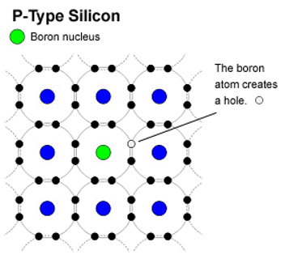
Doping of Semiconductors (Continued)
At room temperature (293 Kelvin), p-type silicon has many more valence band holes than conduction band electrons because each p-type dopant atoms introduces a vacancy in the valence band.
A relatively small number of conduction band electrons (minority carriers) in p-type silicon result from thermally generated electron-hole pairs.
Increasing Electron
Energy
p-type silicon
E_{C}
- - -
Conduction Band
Energy
Bandgap
E_{g}
E_{V}
Valence Band

Slide 13
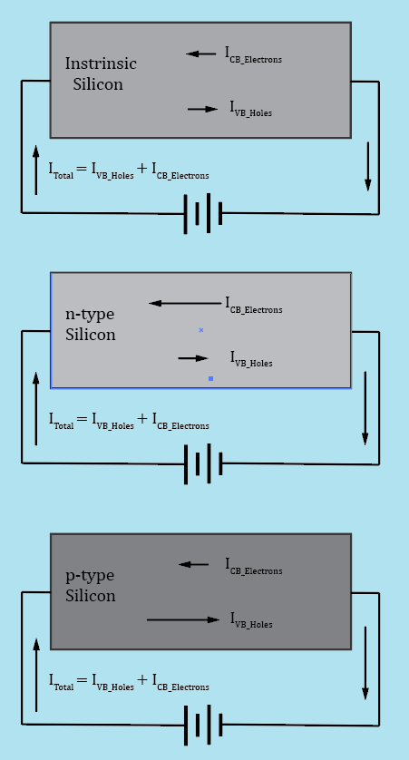
Doping of Semiconductors (Continued)
Conventional current flow (dq/dt) by definition consists of positive
charge transfer from plus to minus.
I_{CB_Electrons} consists of electrons traveling from minus to plus.
I_{VB_Holes} consists of holes, i.e. the absence of valence band electrons,
traveling from plus to minus.
Since positive charge transfer from plus to minus, and/or negative charge
transfer from minus to plus, both contribute to the overall charge transfer,
both conduction band electrons and valence band holes contribute to the
total current flow (dq/dt) for a block of semiconductor such as silicon.
Doping increases the number of available charge carriers for
Temperatures >> 0 Kelvin.
Doping also results in an imbalance between the number
of conduction band electrons and valence band holes for temperatures
>> 0 Kelvin, resulting in majority and minority charge carrier types.

Slide 14
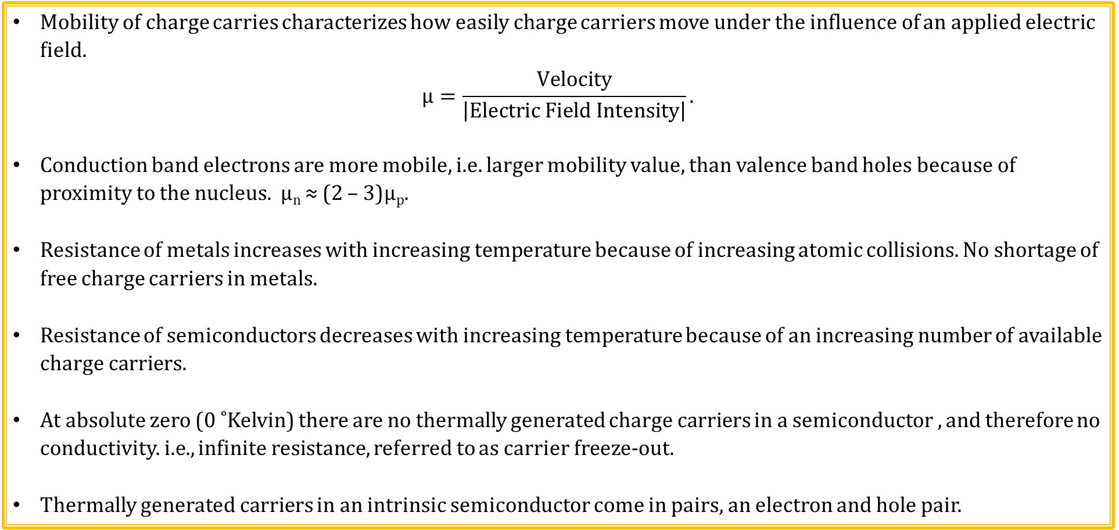
Semiconductor Basics (Continued)
Mobility of charge carries characterizes how easily charge carriers move under the influence of an applied electric field.
$$μ=\frac{Velocity}{\left|Electric Field Intensity\right|}.$$
Conduction band electrons are more mobile, i.e. larger mobility value, than valence band holes because of proximity to the nucleus. µ_{n} ≈ (2 – 3)µ_{p}.
Resistance of metals increases with increasing temperature because of increasing atomic collisions. No shortage of free charge carriers in metals.
Resistance of semiconductors decreases with increasing temperature because of an increasing number of available charge carriers.
At absolute zero (0 ˚Kelvin) there are no thermally generated charge carriers in a semiconductor , and therefore no conductivity. i.e., infinite resistance, referred to as carrier freeze-out.
Thermally generated carriers in an intrinsic semiconductor come in pairs, an electron and hole pair.
7 Poll Questions

Slide 15
Semiconductor Basics - Summary
Silicon is presently the most important semiconductor material in our world.
Intrinsic – pure. Can achieve 1 part in 10 billion for silicon. Number of electrons in the conduction band equals the number of holes in the valence band.
Extrinsic – doped.
Doping – significantly changes characteristics of material. 1 part in 10 million.
n-type Silicon – Doped with Donor atoms – donate an electron. (n - negative).
n- type: Electron → Majority carrier. Hole → Minority carrier.
p-type Silicon – Doped with Acceptor atoms (holes) – accept an electron (p - positive).
p-type: Hole → Majority carrier. Electron → Minority carrier.
n and p type silicon (5:59)

Slide 16
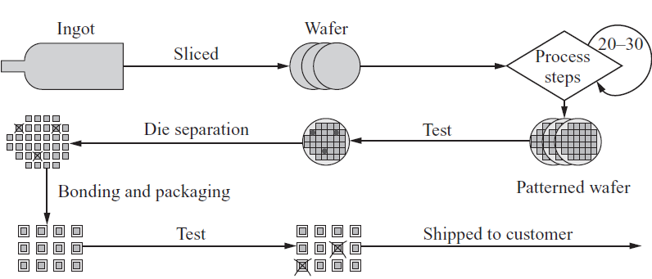
Pictorial View of Integrated Circuit (IC) Processing Technology
Philips Factory IC Manufacturing (10:43)

Slide 17
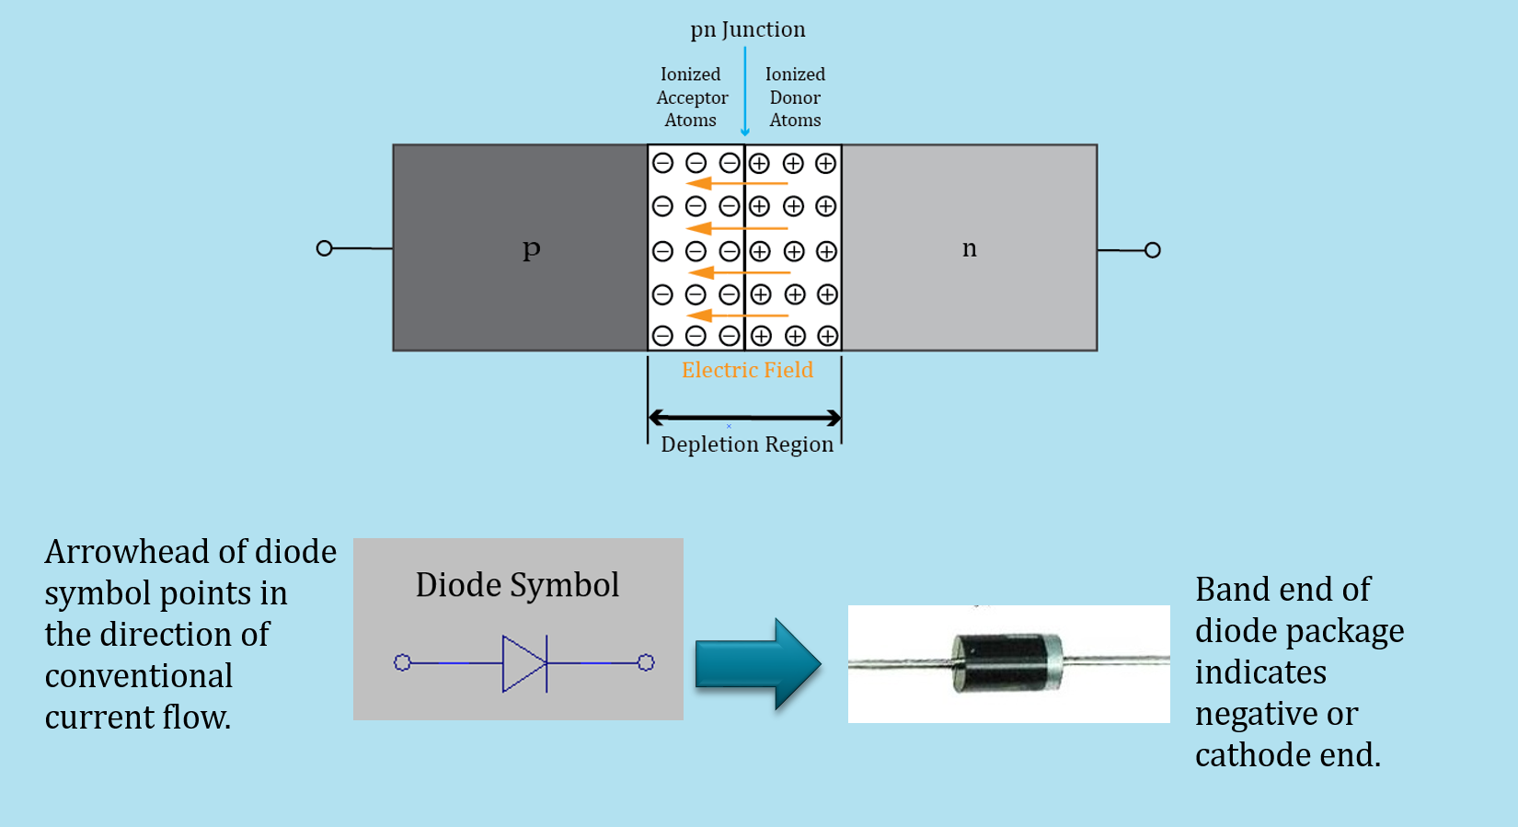
pn Junction Diode

Slide 18
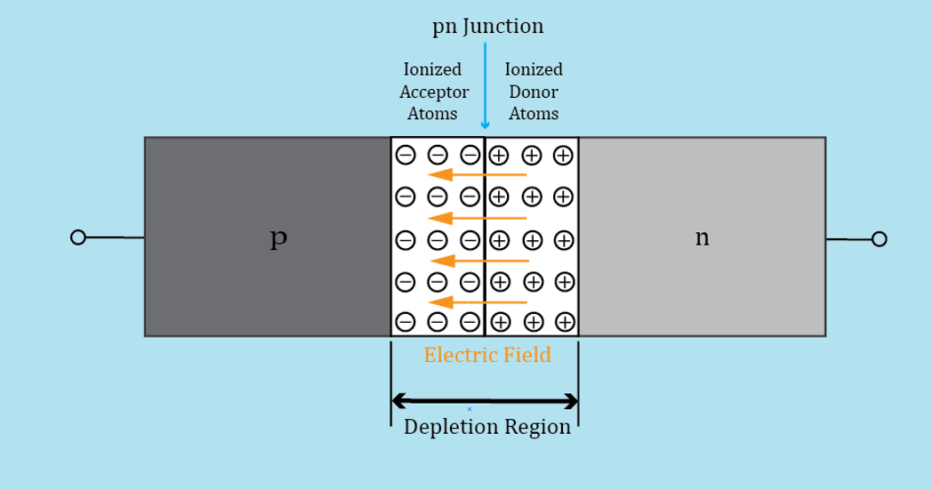
pn Junction - Unbiased
Conduction band electrons from n-side diffuse across the junction filling holes on the p-side near the junction, resulting in ionized acceptor atoms on the p-side, i.e. atoms having a net negative charge because of an extra electron in the valence band for the dopant atoms.
Donor and acceptor atoms are fixed in the crystal lattice and so once they are ionized they do not participate in current flow.
In addition, the loss of conduction band electrons from the n-side near the junction results in ionized donor atoms with net positive charge.
Fixed ions near the junction, referred to as depletion region, because this region is mostly depleted of mobile charge carriers.

Slide 19
pn Junction – Unbiased (Continued)
The fixed ions of the depletion region form an electric field and associated voltage difference referred to as the barrier potential that opposes the crossing of majority carriers.
However, the electric field of the depletion region aids in minority carriers located near the junction to cross the junction.
Consequently, almost all thermally generated minority carriers located in the depletion region up crossing the junction.
An equilibrium is reached where the drift of minority carriers across the junction is balanced by the diffusion of high-energy majority carriers across the junction, resulting in a net current of zero.

Slide 20
pn Junction – Unbiased Summary
Because of the electric field and resulting barrier
potential associated with the depletion region, only the
most energetic conduction band electrons on the
n-side (majority carriers) diffuse across the junction to
the p-side, and only the most energetic holes on the
p-side (majority carriers) diffuse across the junction to
the n-side, resulting in a limited majority carrier diffusion
current.
The electric field associated with the depletion region
aids minority carriers in the depletion region in crossing the junction.
Almost all conduction band electrons located in the p-side of the depletion region cross the junction, as do almost all valence band holes located in the n-side of the depletion region, resulting in a minority carrier drift current.
So the depletion region impedes the diffusion of majority carriers across the junction while aiding the drift of minority across the junction.
The total current across an unbiased pn junction equals zero, with the majority carrier diffusion current across the junction cancelling out the minority carrier drift current.

Slide 21
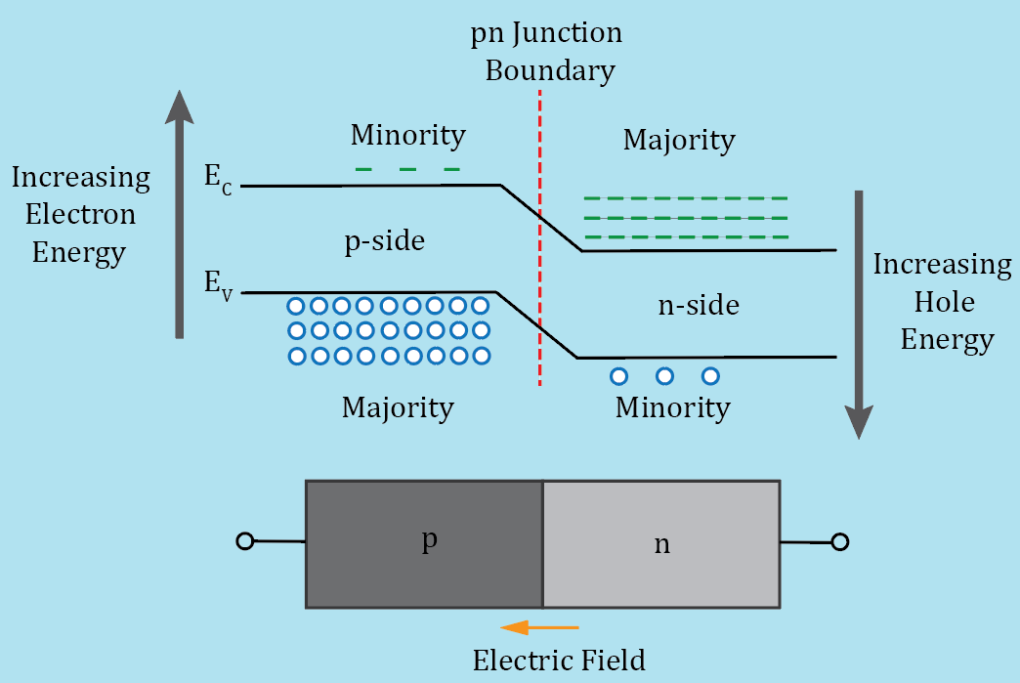
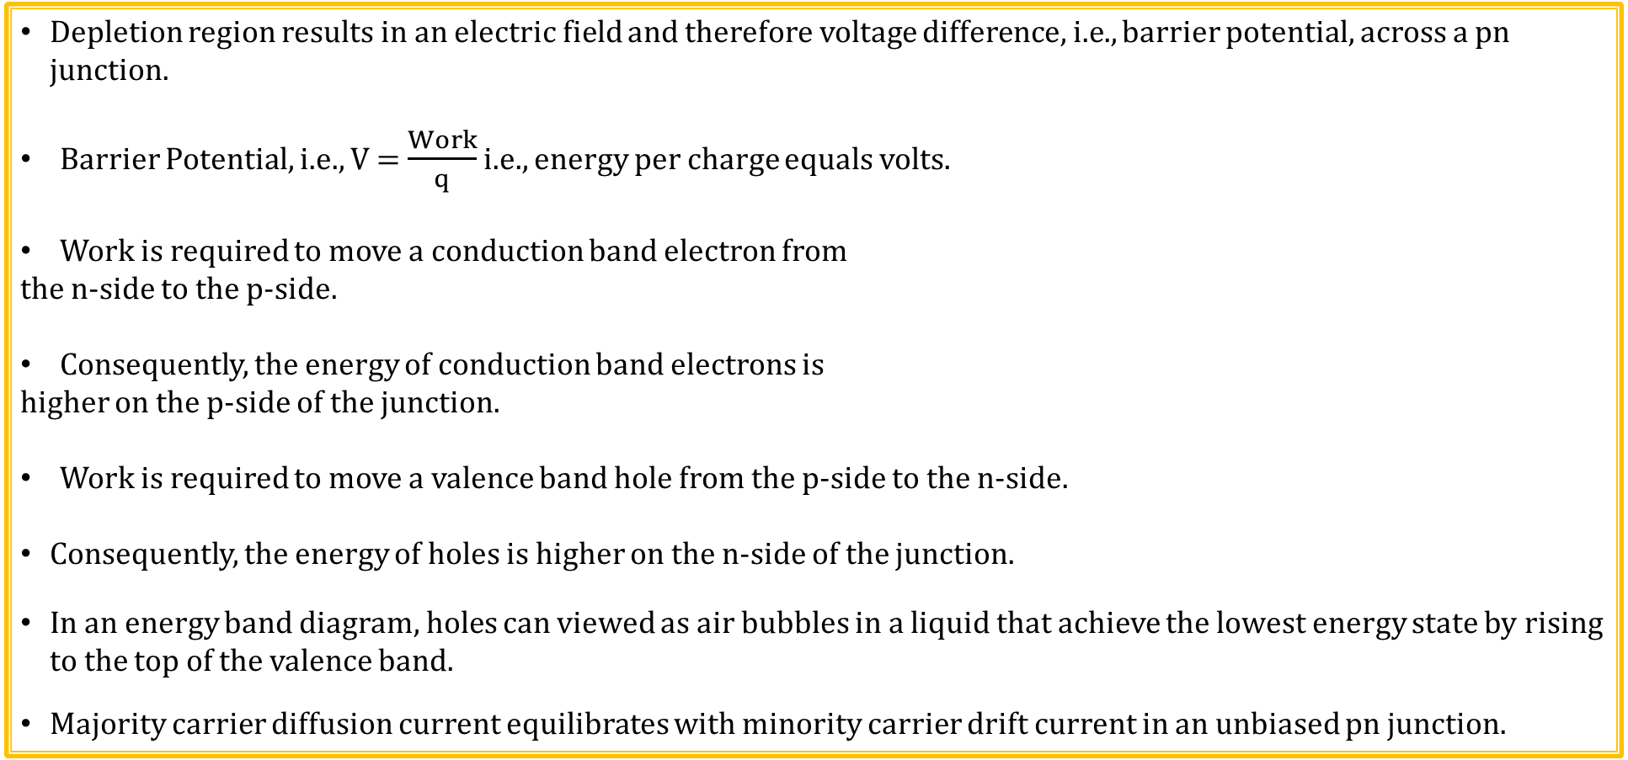
pn Junction Energy Band Diagram – Unbiased
Depletion region results in an electric field and therefore voltage difference, i.e., barrier potential, across a pn junction.
Barrier Potential, i.e., V = $\frac{Work}{q}$ i.e., energy per charge equals volts.
Work is required to move a conduction band electron from
the n-side to the p-side.
Consequently, the energy of conduction band electrons is
higher on the p-side of the junction.
Work is required to move a valence band hole from the p-side to the n-side.
Consequently, the energy of holes is higher on the n-side of the junction.
In an energy band diagram, holes can viewed as air bubbles in a liquid that achieve the lowest energy state by rising to the top of the valence band.
Majority carrier diffusion current equilibrates with minority carrier drift current in an unbiased pn junction.

Slide 22
pn Junction– Unbiased (Continued)
Almost all minority carries ending up in the depletion
region cross the junction.
Silicon solar panels rely on this principle, converting
photon energy from the sun into electron-hole pairs in
the pn junction depletion region.
CB electrons on the p-side readily fall
down the energy hill to the n-side.
VB holes on the n-side readily rise up the energy hill
to the p-side.
So the depletion region impedes the diffusion of majority carriers across the junction while aiding the drift of minority across the junction.
This is important for Bipolar Junction Transistors (BJTs) where minority carriers are intentionally injected into a base region, most of which then cross a reverse biased pn junction to be collected in the collector region.
Minority carrier concentration is strongly temperature dependent as expected for thermally generated minority charge carriers, meaning that minority carrier current increases dramatically with increasing temperature.

Slide 23
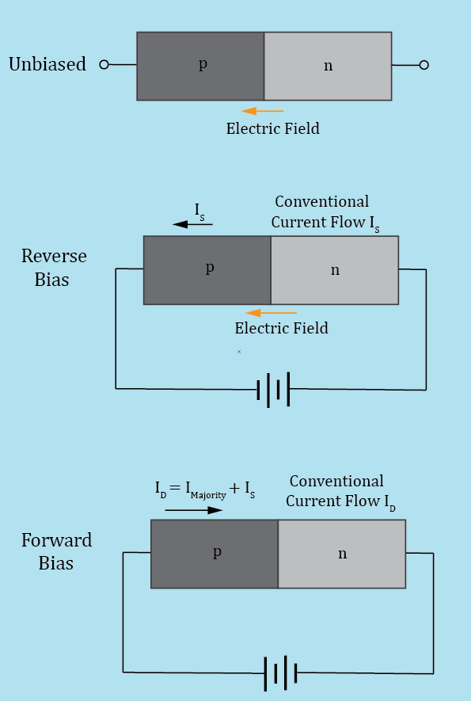
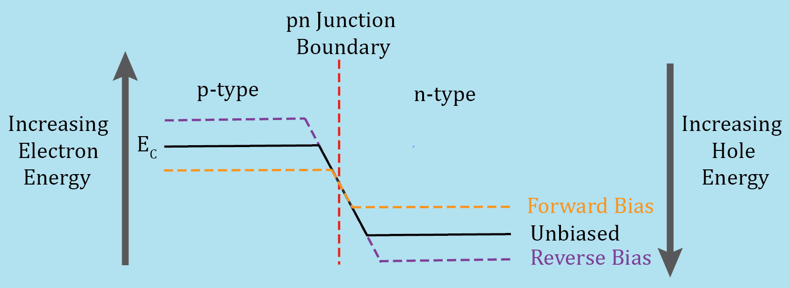
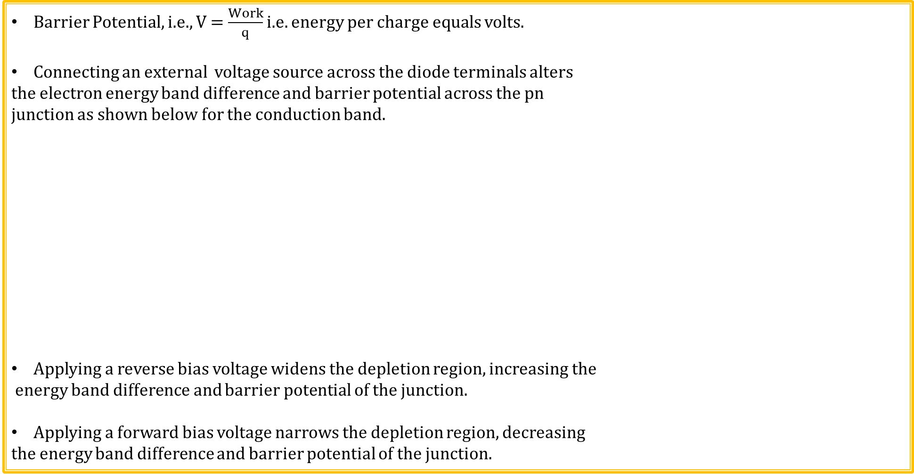
pn Junction Operating Regions
Barrier Potential, i.e., V = $\frac{Work}{q}$ i.e. energy per charge equals volts.
Connecting an external voltage source across the diode terminals alters
the electron energy band difference and barrier potential across the pn
junction as shown below for the conduction band.
Applying a reverse bias voltage widens the depletion region, increasing the
energy band difference and barrier potential of the junction.
Applying a forward bias voltage narrows the depletion region, decreasing
the energy band difference and barrier potential of the junction.
pn Junction Diode Video (10:36)

Slide 24
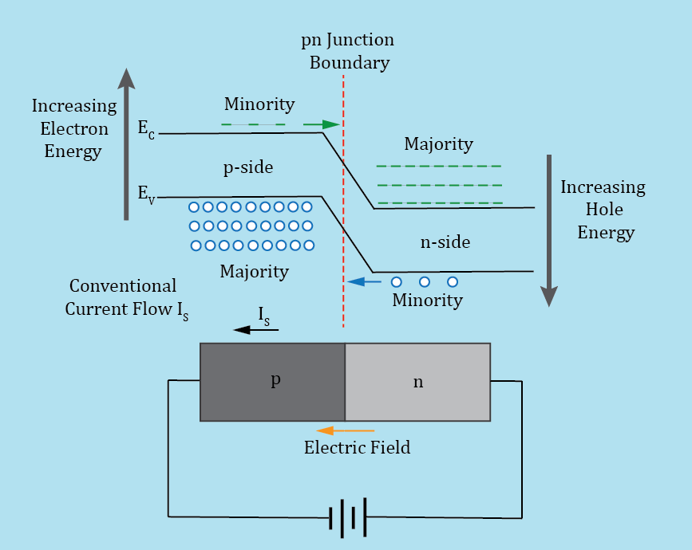
pn Junction Diode – Reverse Bias
With reverse bias, more work is required to move conduction
band electrons from the n-side to the p-side.
Reverse bias widens the depletion region and increases the
barrier potential between the n and p-side of the junction.
For a reverse biased pn junction, the depletion region inhibits
majority carriers from crossing the junction, while aiding minority
carriers to cross the junction.
A relatively small current flowing from the n region to the p region,
referred to as reverse saturation current I_{s}, flows in a reversed biased
pn junction diode. I_{s} consists mostly of minority carriers in the vicinity
of the depletion region crossing the junction. Saturation refers to the
fact that I_{s} reaches a maximum value for a given temperature under reverse bias, only slightly increasing with increasing reverse voltage.
I_{s} is strongly temperature dependent because minority carrier concentration is strongly temperature dependent.
I_{s} approximately doubles for every 10 ˚C increase in temperature.
For a typical silicon pn junction diode at 25˚C , I_{s} << 1 µA.

Slide 25
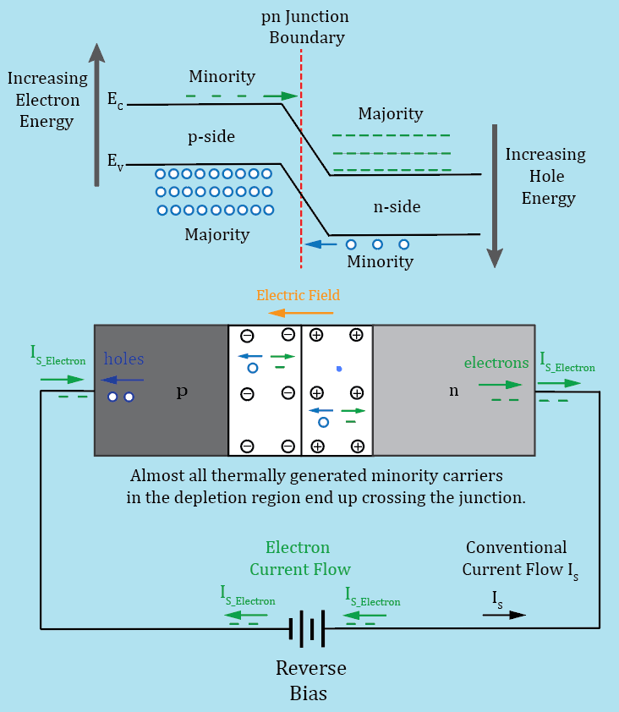
pn Junction Diode – Reverse Bias (Continued)
Thermally generated minority carriers crossing the junction
result in excess electrons on the n-side and excess holes on the
p-side of the junction.
Excess electrons leave the n-side of the diode and return to the
positive terminal of the external battery.
An equal number of electrons leave the negative terminal of the
battery and enter the p-side of the diode, recombining with the
excess holes.
Thermal generation of electron-hole pairs and recombination
are inverse processes.
I_{s} is strongly temperature dependent because minority carrier
concentration is strongly temperature dependent.
I_{s} approximately doubles for every 10 ˚C increase in temperature.
Silicon solar cells utilize photons to generate minority carriers in the depletion region, resulting in a significant I_{s} current, and associated voltage that can be used to power an external load.

Slide 26
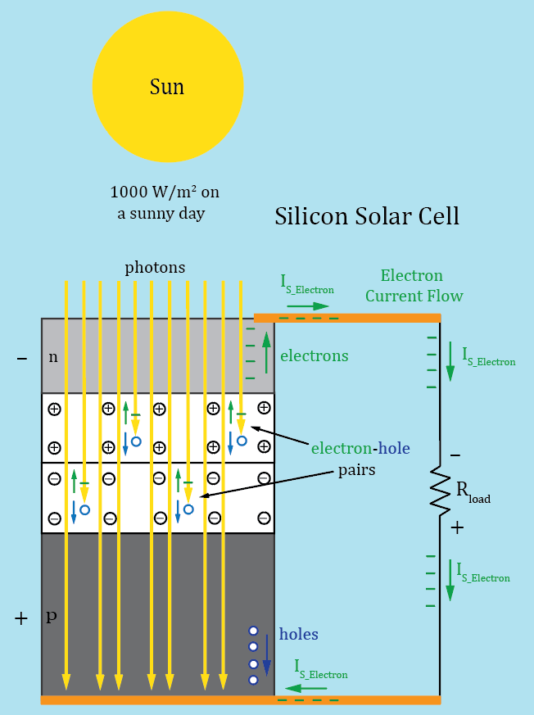
Silicon pn Junction Solar Cell
Photon generated minority carriers, crossing the junction result
in excess electrons on the n-side and excess holes on the p-side.
Excess electrons leave the n-side of the solar cell, flowing through
the load, then enter the p-side of the solar cell, recombining with
excess holes.
Silicon pn junction solar cells convert photon energy into reverse
saturation current I_{s}.
Each solar cell produces a voltage ranging from 0.5 V to 0.6 V
when exposed to sufficient sunlight.
Multiple cells are connected in series to produce a string or module
Multiple modules are connected in series and parallel to produce
solar arrays.
Typical silicon solar panel efficiency is < 20%.
3 Poll Questions

Slide 27
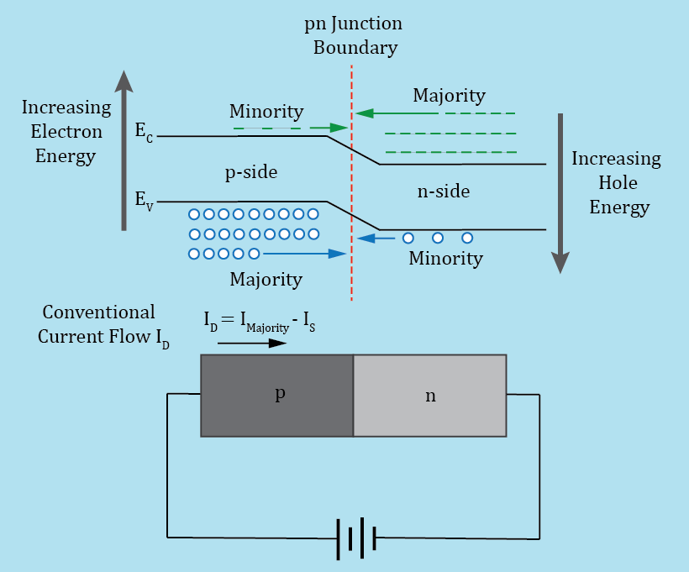
pn Junction Diode – Forward Bias
An externally applied voltage that narrows the depletion
region, decreasing the energy band difference and therefore
voltage difference across the junction, is referred to a forward bias.
Forward bias occurs when the p-type region is connected to a
more positive voltage than the n-type region of a pn junction diode.
Forward bias causes an exponential increase in the number
of majority carriers crossing the pn junction, due to a decrease
in the energy band differences at the junction.
Consequently, diode current I_{D} increases exponentially with
increasing forward bias voltage applied to a diode.
Both n and p-type majority carriers contribute to the overall conventional diode current I_{D} in forward bias.
The diode reverse saturation current still exists with the forward bias, although the relatively small and opposite direction I_{s} current becomes negligible with respect to the majority carrier current for a forward biased diode equal to or greater than the barrier potential, which is approximately 0.7 V for a silicon pn junction diode.

Slide 28
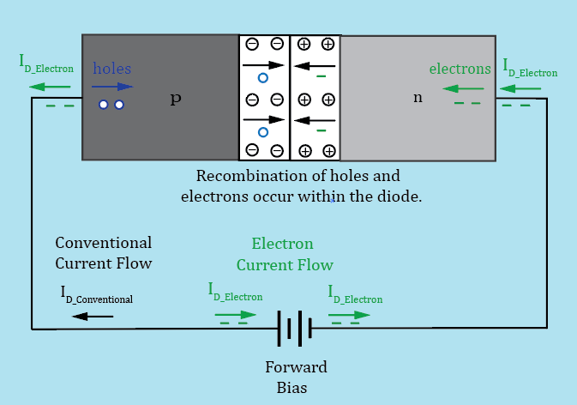
pn Junction Diode – Forward Bias (Continued)
Forward biasing pn junctions results in an exponentially
increasing number of majority carriers crossing the junction.
These majority carriers become minority carriers upon
crossing the junction, resulting in increased electron-hole
recombination occurring within the diode.
Under forward bias, diode current I_{D} flows as follows:
Electrons leave the negative terminal of the battery traveling
through the wire and enter the n-type region as conduction band
electrons. Some conduction band electrons (majority carriers in
n-type region) combine with holes (minority carries in the
n-type region), while others cross the junction to the p-type region. In the p-type region, conduction band electrons are minority carriers and eventually recombine with holes (majority carriers), becoming valence band electrons. Valence band electrons in the p-type region continue movement to the left hoping from hole-to-hole, which can also be viewed as holes, i.e., positive charge, moving to the right. Eventually, valence band electrons reach the left end of the p-type region and move into the wire as free electrons, flowing through the wire to the positive battery terminal.
Within the battery a reduction chemical reaction consumes free electrons at the positive terminal, while an oxidizing chemical reaction produces free electrons at the negative terminal.

Slide 29
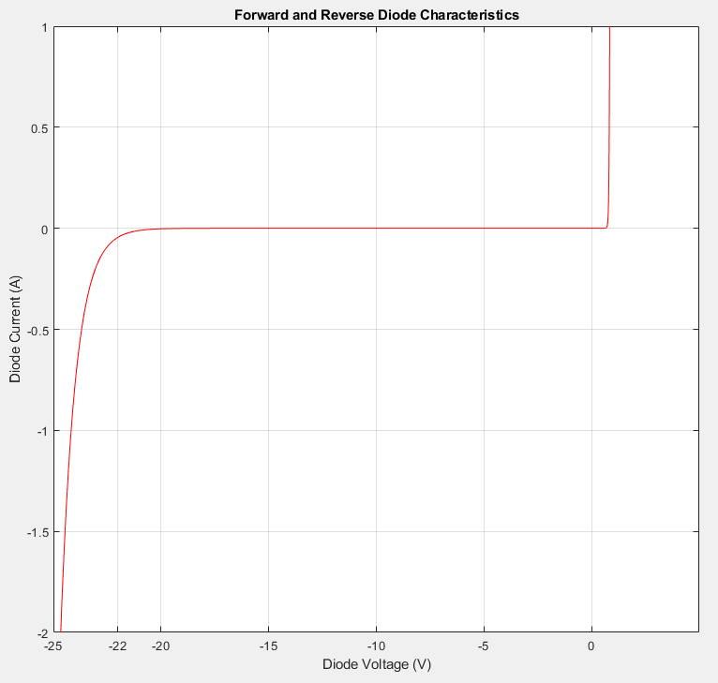
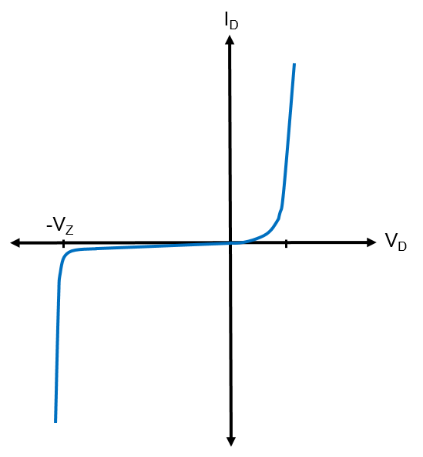
Forward and Reverse Diode Characteristics
Large reverse bias voltages eventually results in a dramatic increase in the reverse saturation current through a process called avalanche breakdown for a standard silicon pn junction diode. Unless current is limited, avalanche breakdown is destructive to the diode because of excessive heating.
The maximum reverse voltage that won’t cause destructive
breakdown is called DC Blocking Voltage (V_{R}), and/or Peak Inverse
(PIV), and/or Peak Repetitive Reverse Voltage (V_{RRM}).
Adjacent diode has a 20 V V_{R} and V_{RRM}.
Special silicon pn junction diodes,
referred to as Zener diodes, are
designed to provide a non-destructive,
well controlled, breakdown voltage.
Zener diodes will be discussed
in more detail later on.

Slide 30
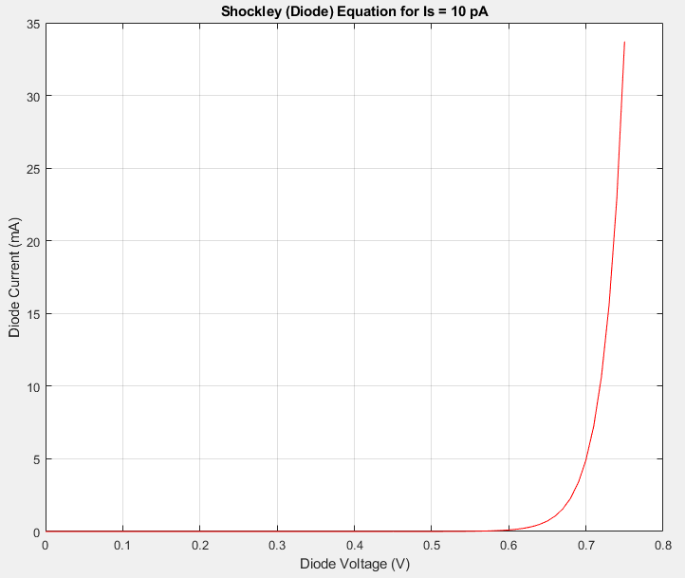
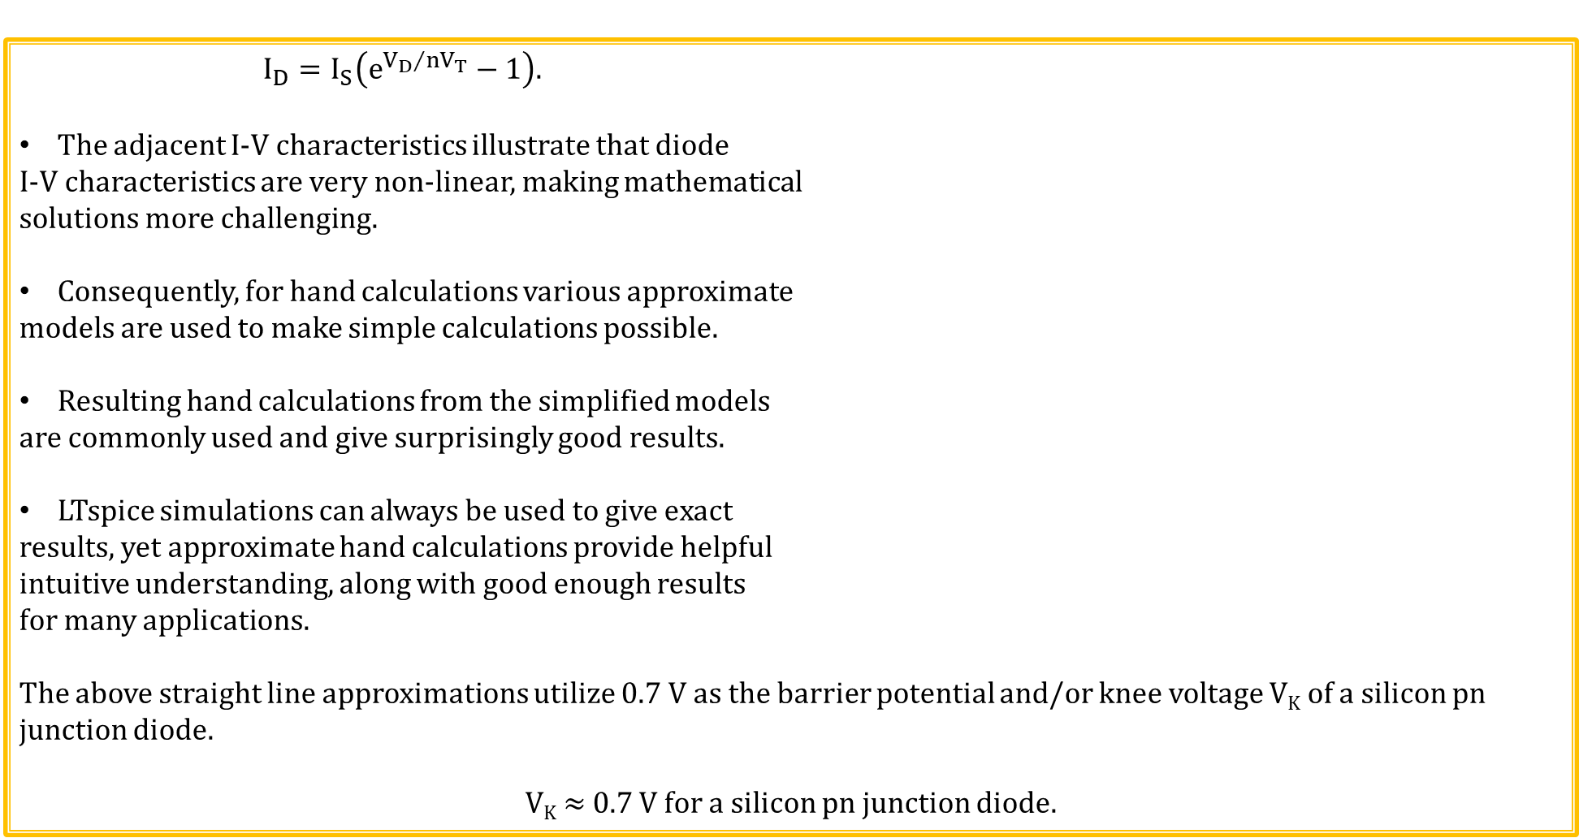
Shockley (Diode) Equation
$$I_{D}=I_{S}\left(e^{{V_{D}}/{nV_{T}}}−1\right).$$
The adjacent I-V characteristics illustrate that diode
I-V characteristics are very non-linear, making mathematical
solutions more challenging.
Consequently, for hand calculations various approximate
models are used to make simple calculations possible.
Resulting hand calculations from the simplified models
are commonly used and give surprisingly good results.
LTspice simulations can always be used to give exact
results, yet approximate hand calculations provide helpful
intuitive understanding, along with good enough results
for many applications.
The above straight line approximations utilize 0.7 V as the barrier potential and/or knee voltage V_{K} of a silicon pn junction diode.
V_{K} ≈ 0.7 V for a silicon pn junction diode.

Slide 31
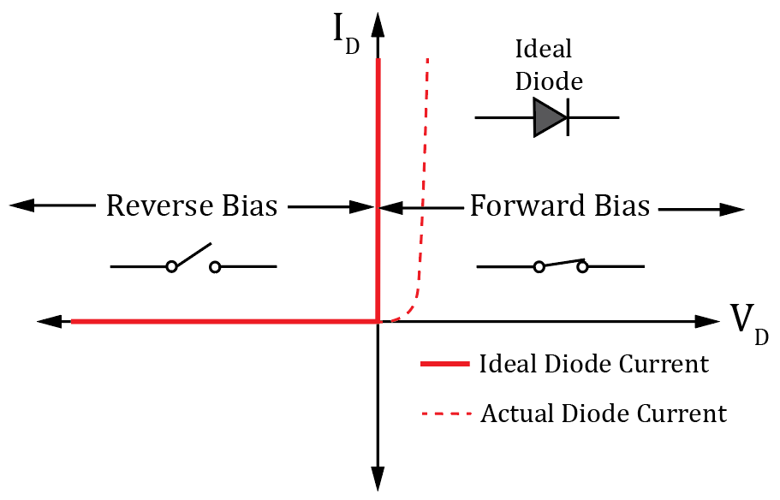
Ideal Diode Model – 1st Approximation
What would you think the ideal diode characteristics would look like?
When forward biased the ideal diode would have 0 V across
it while supporting infinite current, i.e. a closed switch.
When reversed biased the ideal diode would conduct 0 A no
matter how large the applied reverse voltage, i.e. an open switch.
Assume a barrier potential of 0 V for an ideal diode.
Sometimes ideal diode symbol is used to represent an ideal
diode rather than open and closed switches.
Ideal diode model, also referred to as the 1st approximation, is
sometimes used for hand calculations when diode forward bias
voltage is small compared with overall voltage.
For example, for 120 V rms AC line voltage, V_{K} ≈ 0.7 V for a silicon pn junction diode is < 0.5% of the 170 V peak voltage.
Yet V_{K} ≈ 0.7 V for a silicon pn junction diode equals 21 % of a 3.3 V DC voltage.

Slide 32
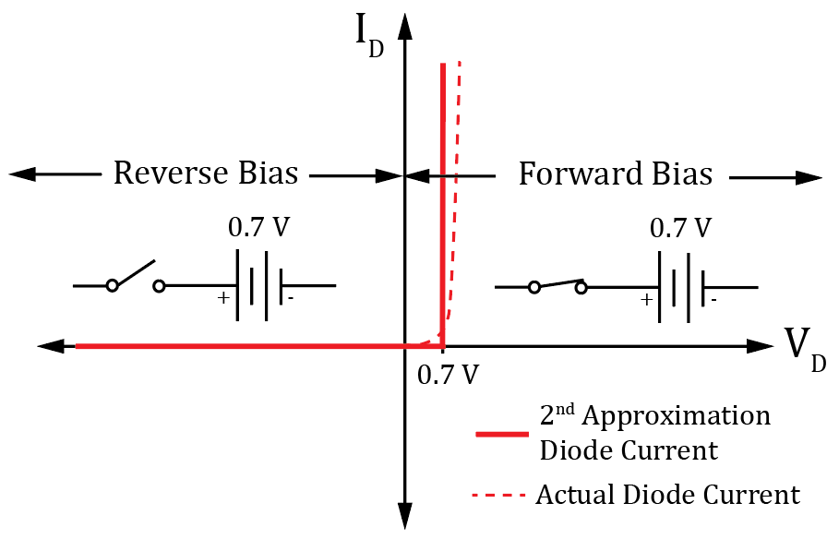
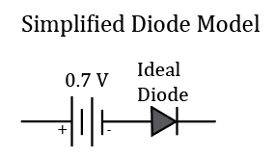
Diode Model – 2nd Approximation
For hand calculations, unless otherwise noted, we will use the 2nd Approximation for diode I-V characteristics, also referred to as the Simplified Diode Model.
For more accurate results than the 2nd Approximation, use LTspice.
For silicon pn junction diode assume a battery voltage of 0.7 V
for the 2nd Approximation.
The battery is simply to indicate that no current flows until
the external applied voltage becomes ≥ the battery voltage.
Reverse bias occurs for the applied diode voltage V_{D} < 0 V.
Forward bias occurs for the applied diode voltage V_{D} > 0 V, although no significant current flows until V_{D} ≥ V_{K} ≥ 0.7 V for a silicon pn junction diode.
In this class consider a diode forward biased for an applied diode voltage V_{D} > 0 V,
which is not a universal definition, i.e. some consider forward bias for V_{D} ≥ V_{K}.
An alternate schematic representation to the open and closed switches is the
adjacent Simplified Diode Model, which is equivalent to the 2nd Approximation.

Slide 33
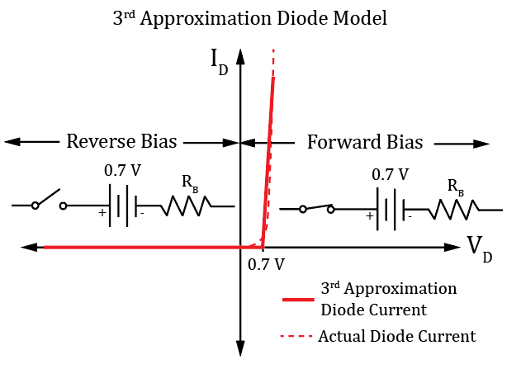
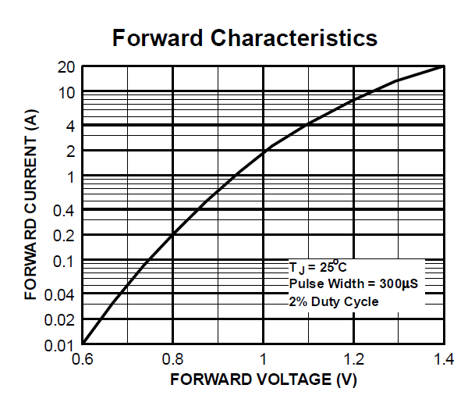
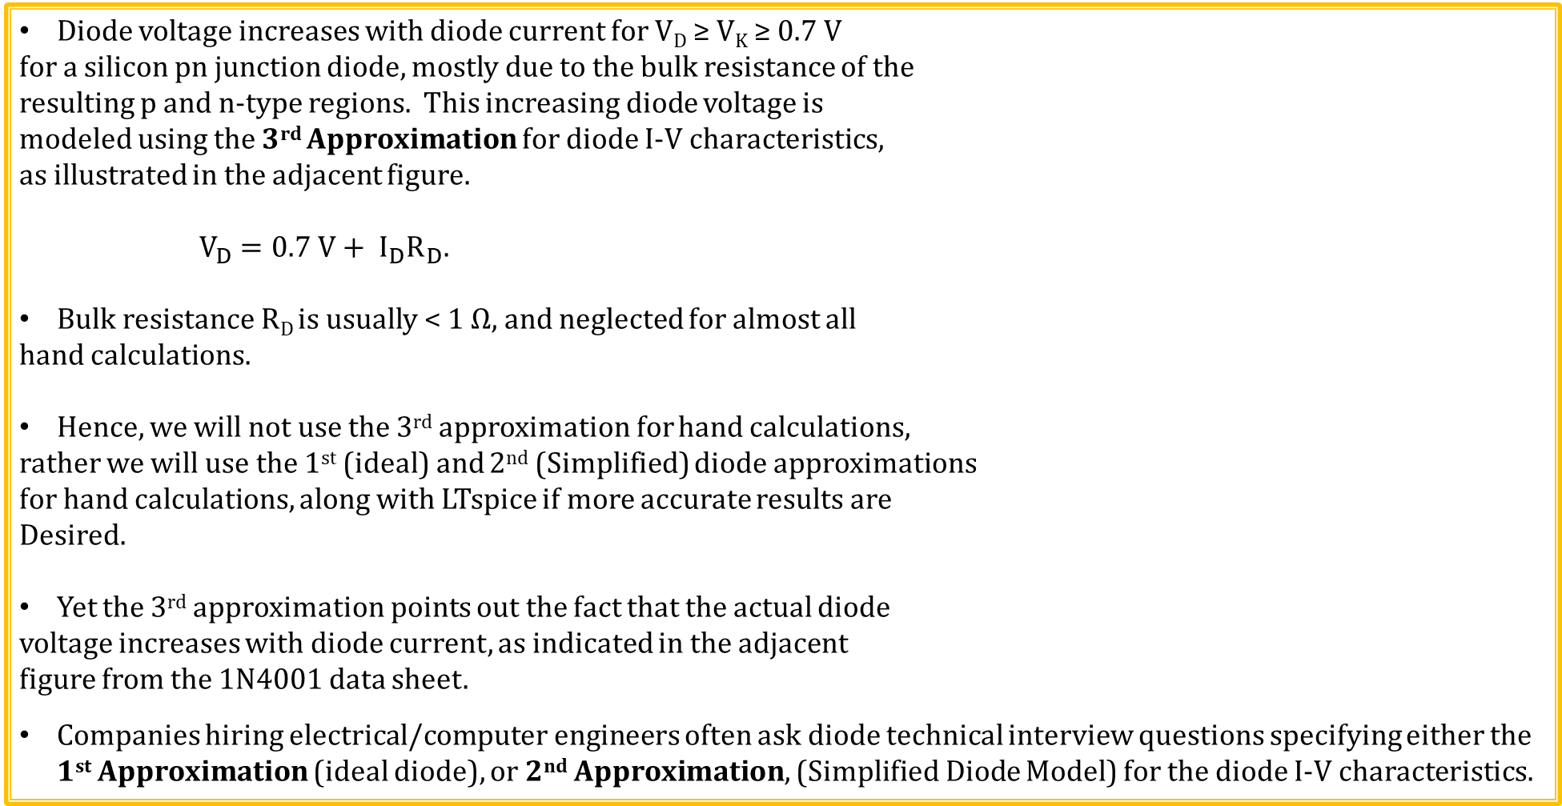
Diode Model – 3rd Approximation
Diode voltage increases with diode current for V_{D} ≥ V_{K} ≥ 0.7 V
for a silicon pn junction diode, mostly due to the bulk resistance of the
resulting p and n-type regions. This increasing diode voltage is
modeled using the 3rd Approximation for diode I-V characteristics,
as illustrated in the adjacent figure.
$$V_{D}=0.7 V+ I_{D}R_{D}.$$
Bulk resistance R_{D} is usually < 1 Ω, and neglected for almost all
hand calculations.
Hence, we will not use the 3rd approximation for hand calculations,
rather we will use the 1st (ideal) and 2nd (Simplified) diode approximations
for hand calculations, along with LTspice if more accurate results are
Desired.
Yet the 3rd approximation points out the fact that the actual diode
voltage increases with diode current, as indicated in the adjacent
figure from the 1N4001 data sheet.
Companies hiring electrical/computer engineers often ask diode technical interview questions specifying either the 1st Approximation (ideal diode), or 2nd Approximation, (Simplified Diode Model) for the diode I-V characteristics.

Slide 34
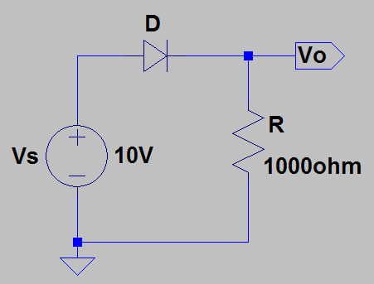
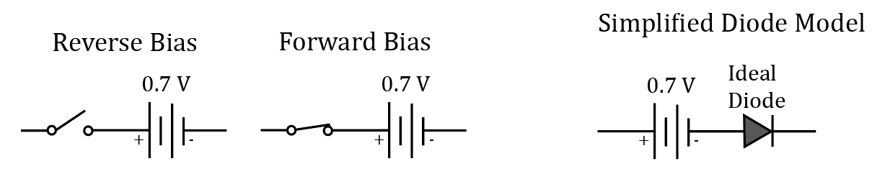
Diode Calculation Example 1
Calculate the current through resistor R in the adjacent circuit, assuming
a standard silicon pn junction diode operating at room temperature.
For hand calculations we will use the Simplified Diode Model, i.e.
2nd Approximation, unless noted otherwise.
V_{o} = 10.0 V – 0.7 V = 9.3 V. I_{R} = (9.3 V)/(1000 Ω) = 9.3 mA.
Hand Calculations: I_{R} = (9.3 V)/(1000 Ω) = 9.3 mA.
LTspice Simulation using 1N4007 Diode Model: I_{R} = 9.29 mA.
Hand calculations using the Simplified Diode Model provide good enough results for most circuit designs.

Slide 35
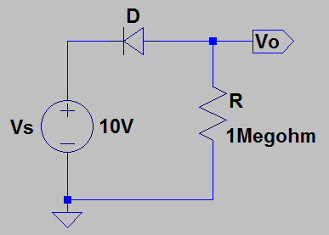
Diode Calculation Example 2
Calculate the output voltage Vo in the adjacent circuit, assuming a
standard silicon pn junction diode operating at room temperature.
For hand calculations we will use the Simplified Diode Model, i.e.
2nd Approximation, unless noted otherwise.
Assume open switch under reverse bias for Simplified Diode Model.
V_{o} = 0.0 V.
Hand Calculations: V_{o} = 0.0 V.
LTspice Simulation using 1N4007 Diode Model: V_{o} = 0.00001 V = 10 µV.
At room temperature the reverse saturation current I_{S} = (10 µV)/(1 MΩ) = 10 pA.
Hand calculations using the Simplified Diode Model provide good enough results for most circuit designs.

Slide 36
Diode Calculation Example 3
Calculate the output voltage Vo in the adjacent circuit, assuming a
standard silicon pn junction diode operating at 125˚C?
For hand calculations we will use the Simplified Diode Model, i.e.
2nd Approximation, unless noted otherwise.
V_{o} = 0.0 V.
Hand Calculations: V_{o} = 0.0 V.
LTspice Simulation using 1N4007 Diode Model: V_{o} = 0.000913 V = 913 µV.
At room temperature the reverse saturation current I_{S} = (913 µV)/(1 MΩ) = 913 pA.
Diode reverse saturation current increases exponentially with temperature. Why?
Because minority carrier concentration increases exponentially with temperature.

Slide 37
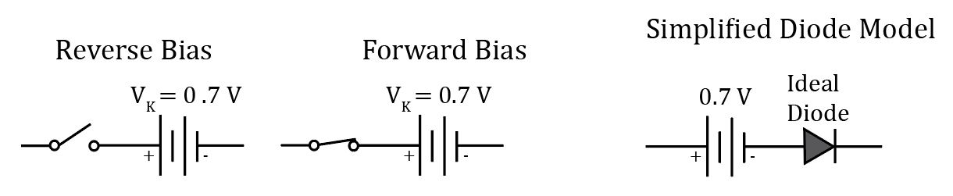
Diode Knee Voltages, i.e., V_{K}
For hand calculations we will use the Simplified Diode Model, i.e., 2nd Approximation, unless noted otherwise.
The battery (forward bias) voltages commonly used for the simplified diode models are as follows:
silicon pn junction diode, knee voltage V_{K} ≈ 0.7 V.
germanium pn junction diode, knee voltage V_{K} ≈ 0.3 V.
Schottky (metal-semiconductor) diode, knee voltage V_{K} ≈ 0.3 V.
Schottky diodes utilize a metal-semiconductor junction with resulting lower knee voltage as compared to silicon pn junction diodes. Schottky diodes will be discussed in more detail later on.
In this class consider a diode forward biased for an applied diode voltage V_{D} > 0 V, which is not a universal definition, i.e. some consider forward bias for V_{D} ≥ V_{K}. Situations occur where non-negligible diode current flow occurs when V_{D} is only 70 to 95% of V_{K}.
3 Poll Questions

Slide 38
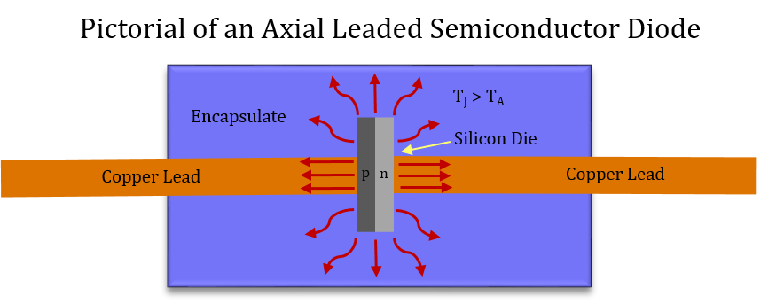
Semiconductor Junction Temperature
For reliable semiconductor performance need to verify
that maximum, worst-case junction temperature, i.e. T_{J},
does not exceed specified limits.
Usually want maximum T_{J} < 150 ˚C for long term
reliability, although nowadays, many silicon pn junction
diodes specify a maximum recommended T_{J} < 175 ˚C.
Check device datasheets to find recommended maximum T_{J} for good long-term reliability.
Operating a semiconductor device with T_{J} > maximum recommended T_{J} results in shortened device life-time.
Electrical Resistance → Opposition to current flow in units of V/A = Ω.
Thermal Resistance → Opposition to heat flow in units of ˚C/Watt.
R_{θJA} → Thermal Resistance Junction to Ambient.
J → Junction. A → Ambient. (Ambient – surroundings).
Because of internal power dissipation along with opposition to heat flow, (R_{θJA}), die (junction) temperature of semiconductor devices is often much hotter than external (ambient) temperature.

Slide 39
Thermal Resistance (Continued)
For many semiconductor applications, it is necessary to
calculate maximum, worst-case junction temperature T_{J}, based
on power dissipation, thermal resistance R_{θJA}, and worst-case
ambient temperature T_{A}.
Units of thermal resistance R_{θJA} are ˚C/W.
Multiplying R_{θJA} by device power dissipation gives junction temperature increase in ˚C.
Mathematically: T_{J} = T_{A} + ∆T_{J}, where ∆T_{J} is the increase in junction temperature due to device power dissipation and thermal resistance, i.e., ∆T_{J} = PR_{θJA}.
T_{J} = T_{A} + ∆T_{J} = T_{A} + PR_{θJA}. T_{J} = T_{A} + PR_{θJA}.
For good long-term reliability, want T_{J} less than the recommended maximum operating junction temperature, which has been 150 ˚C for many semiconductor devices.
Nowadays, some semiconductor devices specify 175 ˚C, instead of 150 ˚C as the maximum recommended operating junction temperature. Check the device device datasheet to be sure.

Slide 40
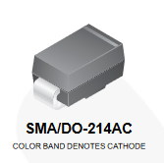
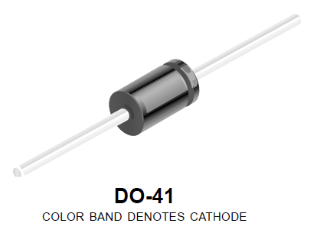
Thermal Resistance Example
Choose a silicon pn junction diode for a 40 V reversal protection application requiring up to 1 A dc of diode
forward current with a maximum ambient temperature of 85 ˚C.
Try On-Semiconductor RGF1A Surface Mount Diode with V_{RRM} = 40 V.
From the data sheet: R_{θJA}= 85 ˚C/W, , V_{D} = 1.3 V max @ A, I_{D} = 1.0 A, and T_{Jmax}= 175 ˚C.
P_{D}= (1.0 A)(1.3 V) = 1.3 W. ∆T_{J}= P_{D}R_{θJA}= (1.3 W)(85 ˚C/W) = 110 ˚C.
T_{J} = T_{A} + ∆T_{J} = T_{A} + P_{D}R_{θJA} = 85 ˚C + 110 ˚C = 195 ˚C.
T_{J} = 195 ˚C, which is well above T_{jmax} = 175 ˚C. The SM RGF1A is not suitable for this application. We need either lower diode forward voltage at a current of 1 A, or lower thermal resistance.
Try On-Semiconductor GF1A Surface Mount Diode in same package with V_{RRM} = 40 V.
From the data sheet: R_{θJA}= 80 ˚C/W, V_{D} = 1.0 V max @ A, I_{D} = 1.0 A, and T_{Jmax}= 175 ˚C.
P_{D}= (1.0 A)(1.0 V) = 1.0 W. ∆T_{J}= P_{D}R_{θJA}= (1.0 W)(80 ˚C/W) = 80 ˚C.
T_{J} = T_{A} + ∆T_{J} = T_{A} + P_{D}R_{θJA} = 85 ˚C + 80 ˚C = 165 ˚C. The SM GF1A is suitable for this application.
Also, through-hole IN4001 diodes in DO-41 package have R_{θJA}= 80 ˚C/W, and T_{Jmax}= 175 ˚C.

Slide 41
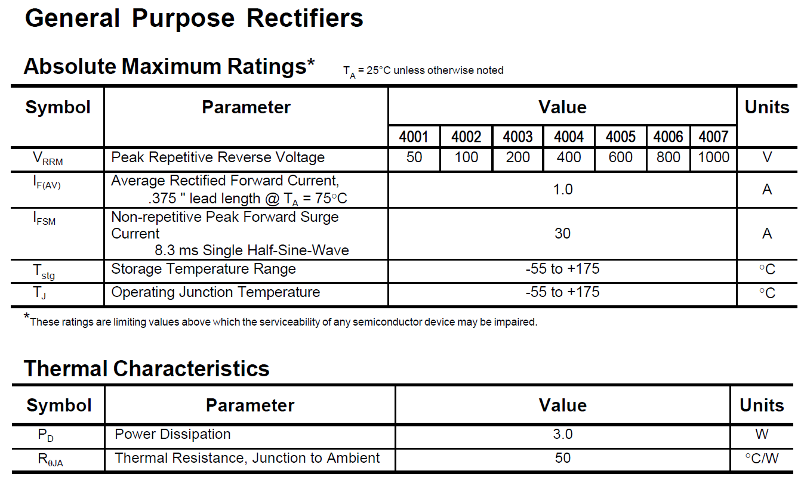
1N4001 – 1N4007 Data Sheet
Data Sheet from Fairchild Semiconductor for 1N4001-1N4007.

Slide 42
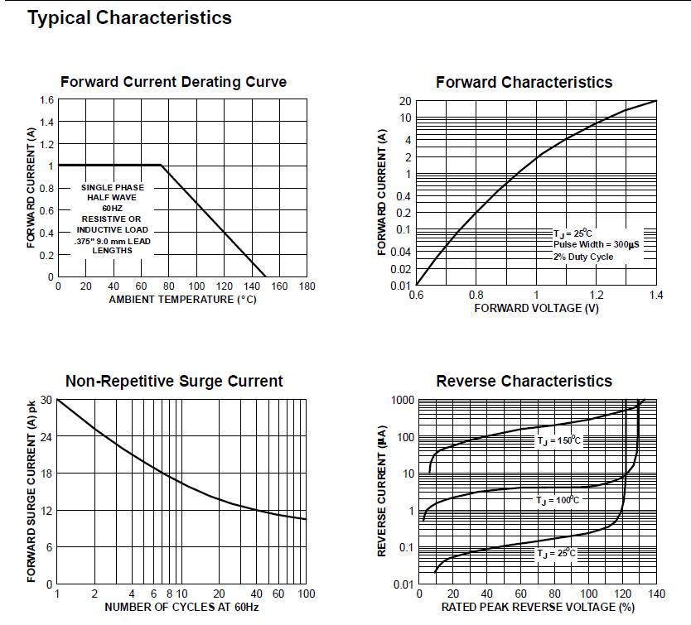
1N4001 – 1N4007 Data Sheet (Continued)
Data Sheet from Fairchild Semiconductor for 1N4001-1N4007.

Slide 43
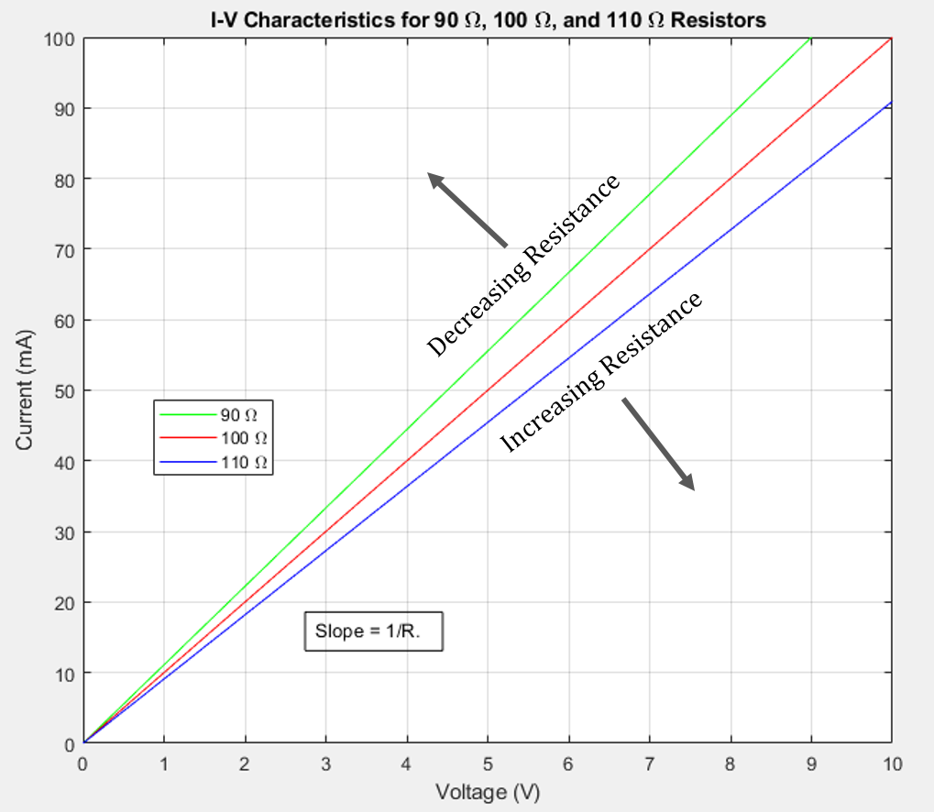
Ohm’s Law Graphically
Constant (Linear) Resistance on an I-V graph.
Diode I-V characteristics are non-linear and so can’t be characterized by a single slope value.

Slide 44
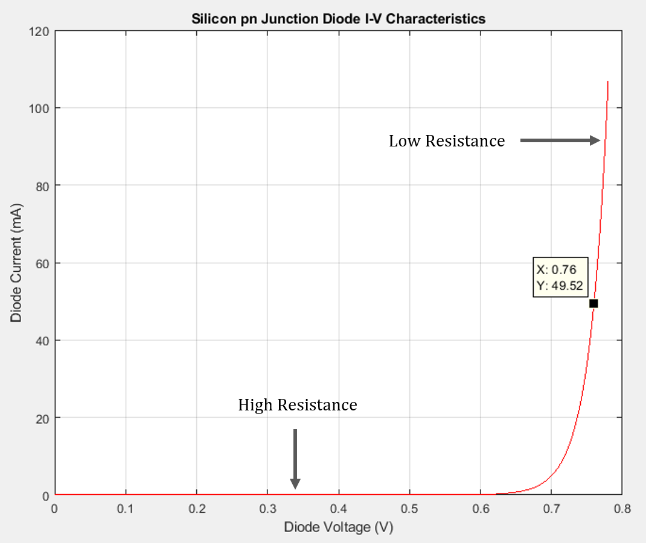
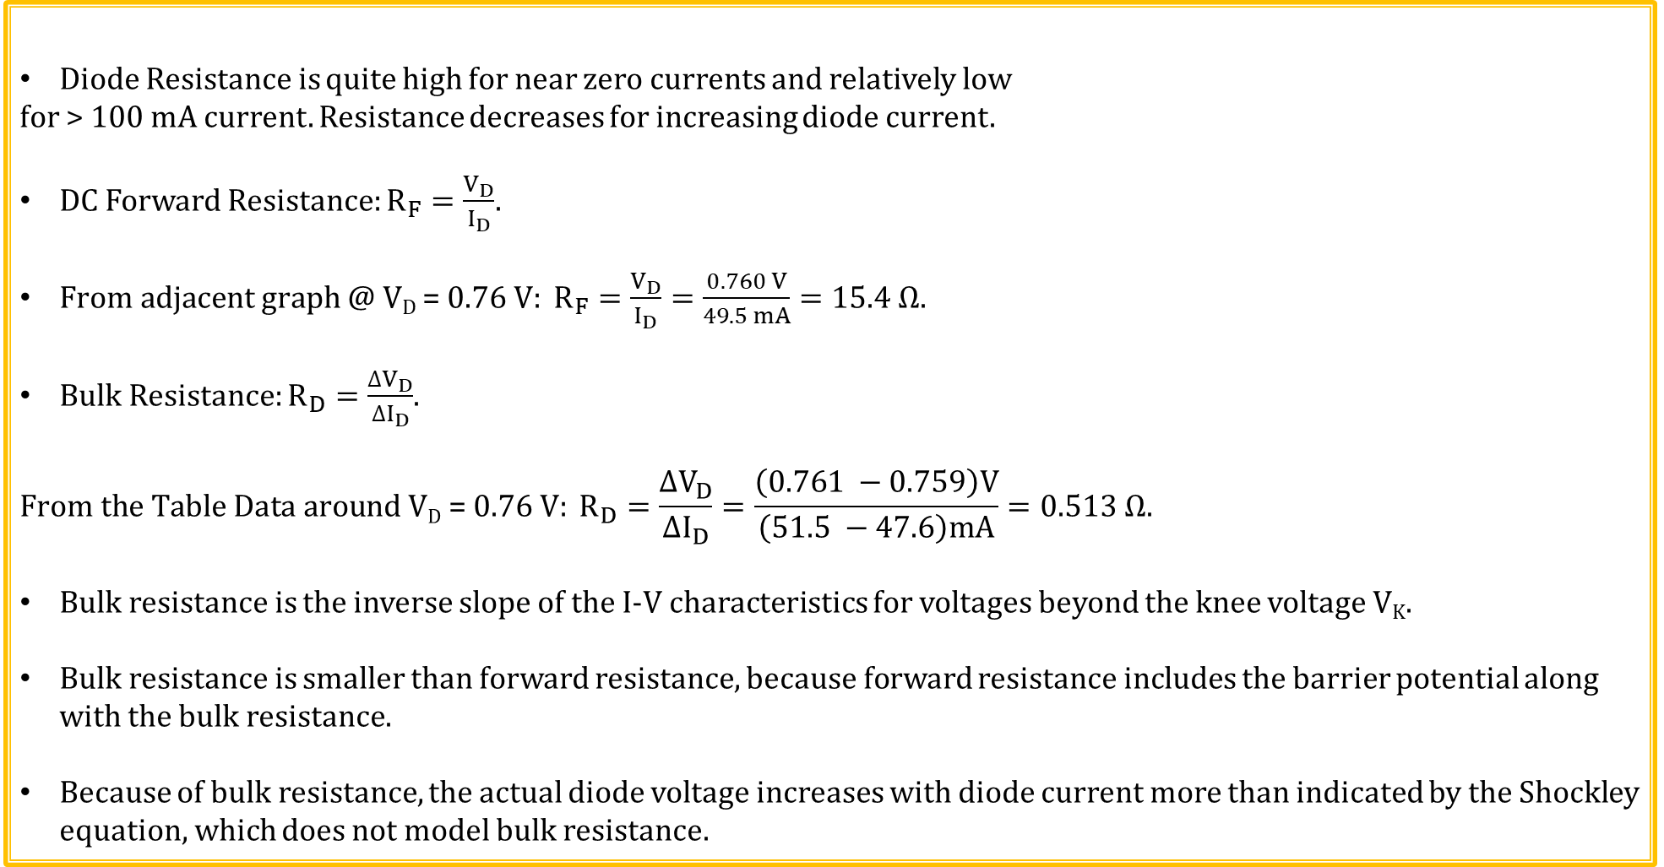
Diode Resistance
Diode Resistance is quite high for near zero currents and relatively low
for > 100 mA current. Resistance decreases for increasing diode current.
DC Forward Resistance: $R_{F}=\frac{V_{D}}{I_{D}}$.
$From adjacent graph \text{@ }\text{VD}\text{ = 0.76 }\text{V}: R_{F}=\frac{V_{D}}{I_{D}}=\frac{0.760 V}{49.5 mA}=15.4 Ω.$
Bulk Resistance: $R_{D}=\frac{{∆V}_{D}}{{∆I}_{D}}$.
$$From the Table Data \text{around} \text{VD}\text{ = 0.76 }\text{V}: R_{D}=\frac{{∆V}_{D}}{{∆I}_{D}}=\frac{\left(0.761 −0.759\right)V}{\left(51.5 −47.6\right)mA}=0.513 Ω.$$
Bulk resistance is the inverse slope of the I-V characteristics for voltages beyond the knee voltage V_{K}.
Bulk resistance is smaller than forward resistance, because forward resistance includes the barrier potential along with the bulk resistance.
Because of bulk resistance, the actual diode voltage increases with diode current more than indicated by the Shockley equation, which does not model bulk resistance.
V_{D} (V) | I_{D} (mA)
0.759 | 47.6
0.760 | 49.5
0.761 | 51.5

Slide 45
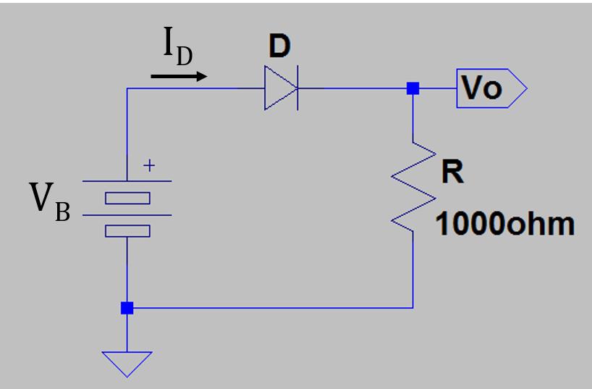
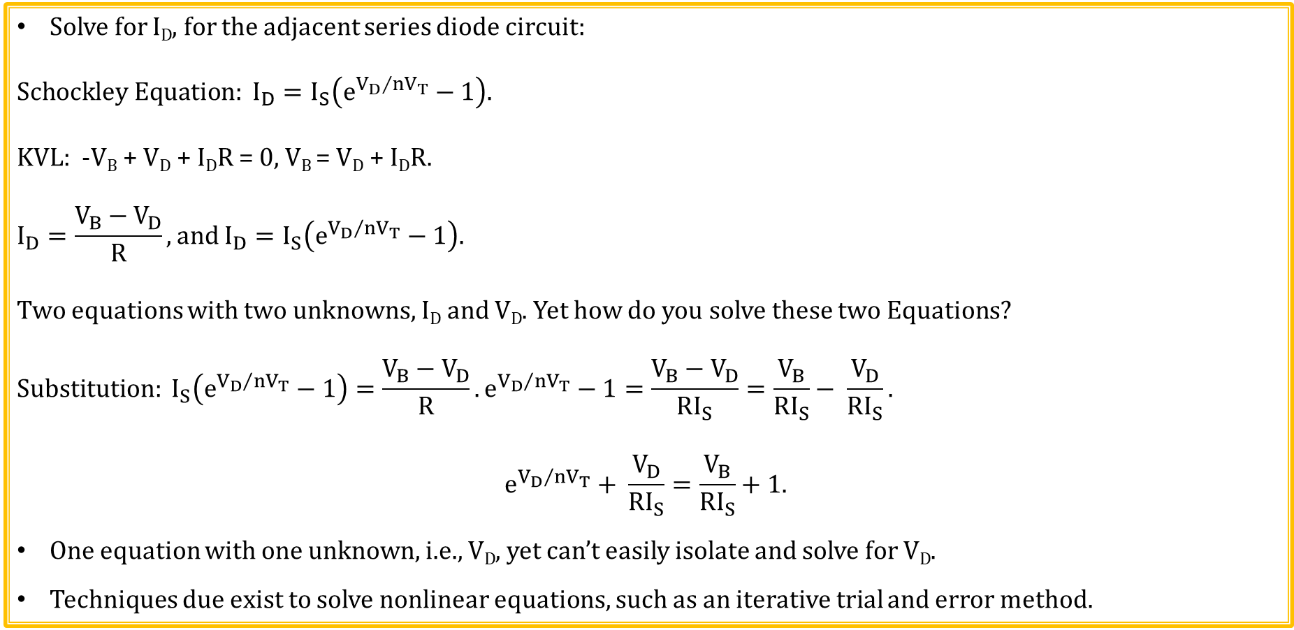
Series Diode Circuit
Solve for I_{D}, for the adjacent series diode circuit:
$$Schockley Equation: I_{D}=I_{S}\left(e^{{V_{D}}/{nV_{T}}}−1\right).$$
KVL: -V_{B} + V_{D} + I_{D}R = 0, V_{B} = V_{D} + I_{D}R.
$$I_{D}=\frac{V_{B}−V_{D}}{R}, and I_{D}=I_{S}\left(e^{{V_{D}}/{nV_{T}}}−1\right).$$
Two equations with two unknowns, I_{D} and V_{D}. Yet how do you solve these two Equations?
$$Substitution: I_{S}\left(e^{{V_{D}}/{nV_{T}}}−1\right)=\frac{V_{B}−V_{D}}{R}. e^{{V_{D}}/{nV_{T}}}−1=\frac{V_{B}−V_{D}}{RI_{S}}=\frac{V_{B}}{RI_{S}}− \frac{V_{D}}{RI_{S}}.$$
$$e^{{V_{D}}/{nV_{T}}}+ \frac{V_{D}}{RI_{S}}=\frac{V_{B}}{RI_{S}}+1.$$
One equation with one unknown, i.e., V_{D}, yet can’t easily isolate and solve for V_{D}.
Techniques due exist to solve nonlinear equations, such as an iterative trial and error method.

Slide 46
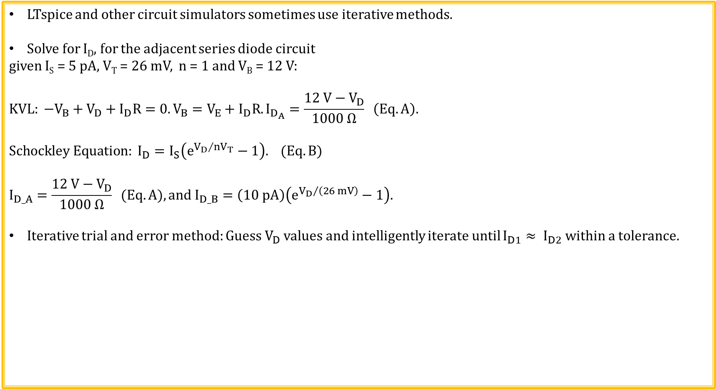
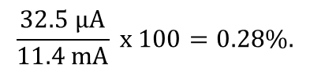
Series Diode Circuit Solution Using Iterative Method
LTspice and other circuit simulators sometimes use iterative methods.
Solve for I_{D}, for the adjacent series diode circuit
given I_{S} = 5 pA, V_{T} = 26 mV, n = 1 and V_{B} = 12 V:
$$KVL: −V_{B}+V_{D}+I_{D}R=0. V_{B}=V_{E}+I_{D}R. I_{D_{A}}=\frac{12 V−V_{D}}{1000 Ω} \left(Eq. A\right).$$
$$Schockley Equation: I_{D}=I_{S}\left(e^{{V_{D}}/{nV_{T}}}−1\right). (Eq. B)$$
$$I_{D_A}=\frac{12 V−V_{D}}{1000 Ω} (Eq. A), and I_{D_B}=\left(10 pA\right)\left(e^{{V_{D}}/{\left(26 mV\right)}}−1\right).$$
Iterative trial and error method: Guess $V_{D}$ values and intelligently iterate until $I_{D1}≈ I_{D2}$ within a tolerance.
V_{D} | I_{D_A} | I_{D_B} | I_{D_A} – I_{D_B}
0.6 V 11.4 mA 10.5 mA 876 µA Need V_{D} a little larger.
0.61 V 11.4 mA 15.5 mA -4.1 mA Not that large.
0.603 V 11.4 mA 11.8 mA -414 µA Need V_{D} a little smaller.
0.602 V 11.4 mA 11.4 mA 32.5 µA Close enough.
$$\frac{32.5 μA}{11.4 mA} x 100=0.28\%.$$

Slide 47
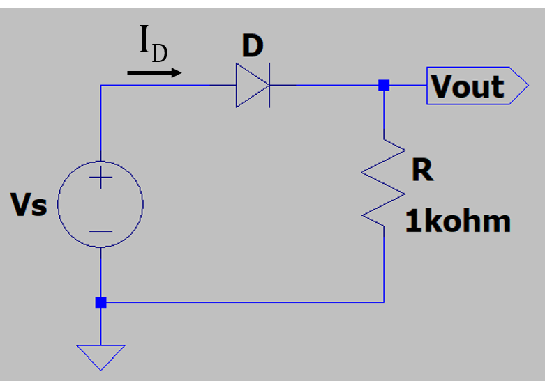
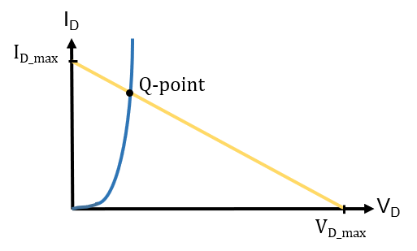
Load Line for Series Diode Circuit
Load line is a graphical way to solve for diode operating point when we
want an answer more accurate than obtained from the simplified diode model
(2nd approximation) of V_{D} = 0.7 V for forward biased silicon pn junction diode.
KVL: -V_{s} + V_{D} + I_{D}R = 0, V_{s} = V_{D} + I_{D}R.
The circuit constrains diode voltage V_{D} to be somewhere between 0 V and
V_{s} volts, and diode current I_{D} to be somewhere between 0 A and V_{S}/R A.
Look at end-point extremes for V_{D} and I_{D}:
For V_{D} = 0 V, I_{D} = I_{D_max} = V_{s}/R.
For I_{D} = 0 A, V_{D} = V_{D_max} = V_{s}.
Superimpose diode characteristics over the resulting load line
to determine the actual operating, or Q point.
LTspice has mostly replaced the usage of load-lines for diode circuits, although load lines prove useful when designing transistor amplifier circuits to be discussed later.

Slide 48
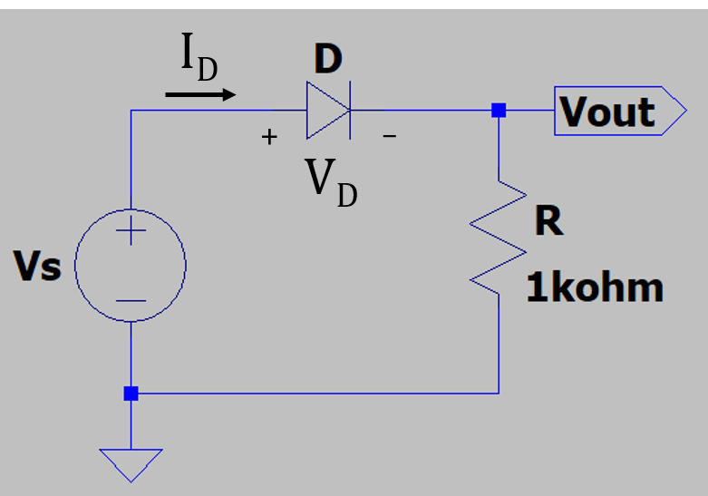
Load Line Example
Determine V_{D_max} and I_{D_max} of the Load line for the adjacent circuit,given that V_{s} = 8 V.
Look at end-point extremes for V_{D} and I_{D}:
V_{D_max} equals the voltage across didoe D if it was an open circuit.
I_{D_max} equals the current through resistor R if diode D was a short circit.
For diode D shorted: V_{D} = 0 V, I_{D} = I_{D_max} = V_{s}/R = (8 V)/(1 kΩ) = 8 mA.
For diode D open: I_{D} = 0 A, V_{D} = V_{D_max} = V_{s} = 8 V.
I_{D_max} = 8 mA. V_{D_max} = 8 V.
Superimpose diode characteristics over the resulting load line
to determine the actual operating, or Q point.
The Q-point is the only point on the adjacent graph that the resulting diode
circuit can operate at for a given diode characteristics.
Q-Point also referred to a quiescent (quiet) operating point.
3 Poll Questions

Slide 49
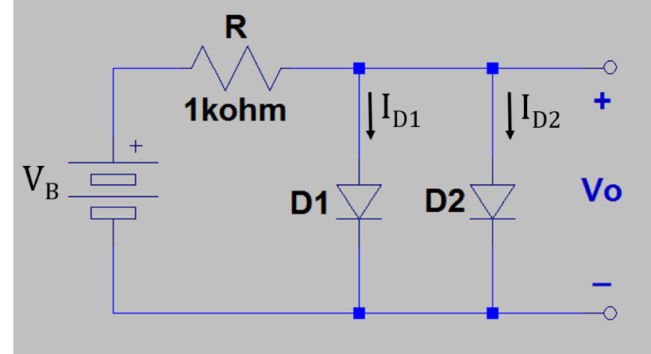

Parallel Diodes
Why would you be tempted to
connect diodes in parallel?
Reduce the current and/or power dissipation requirements
for an individual diode.
While theoretically this sounds reasonable, it does not
work well in practice.
Why?
Diode forward voltage decreases with
increasing temperature, resulting in the
hotter diode taking more current, resulting
in increasing temperature. This positive
feedback results in diodes not sharing current
well.

Slide 50
Parallel Diodes (Continued)
Why does paralleling diodes to reduce the current and/or power dissipation requirements for an individual diode not work well in practice?
Problem is that diode barrier potential or knee voltage and therefore forward voltage V_{D} decreases by approximately 2 mV/˚C with increasing temperature for a given current, i.e. diode forward voltage has a negative temperature coefficient. Diode with the lowest forward voltage conducts the most current, which increases the temperature of that diode, further reducing the forward voltage, and on and on.
Result is that parallel diodes don’t share the total parallel current well because of the positive feedback mechanism for conduction current associated with the negative TC of the diode forward voltage.
Parallel diodes likely reduce the individual diode power dissipation compared to a single diode, although it is quite difficult to calculate by how much.
How could the very linear diode forward voltage decrease of approximately 2 mV/˚C for a given current be useful?
IC Temperature sensors use this principle.

Slide 51

Diode Reverse Recovery Time (t_{rr})
Forward biased pn junction diodes have many injected minority carriers in both the p and n-type regions that eventually recombine with the majority carrier type.
The pn junction inhibits majority carriers from crossing, while aiding the
crossing of minority carriers.
Consequently, upon abruptly switching from forward to reverse bias, the
Elevated minority carrier concentration contributes to an initial reverse current
of magnitude similar to the forward current, until the minority carriers dissipate.
Reverse recovery time (t_{rr}): Time duration of elevated reverse current flow
upon switching from forward to reverse bias voltage across a pn junction
diode.
Specified reverse recovery time of the relatively slow 1N4007 diode
is 30 µs.
High-speed switching diodes have reverse recovery times on the
order of 1 ns.

Slide 52


Diode Capacitance
Capacitance – Provides voltage inertia due to separated charge.
Capacitance opposes a change in voltage, resulting in limitations in switching
speeds.
For reversed biased diode, separated charges of the depletion region result in a junction capacitance. This reverse biased junction capacitance decreases with increasing reverse bias voltage because of widening depletion region width.
For forward biased diode, large minority carrier concentration exists on each
side of the depletion region. The resulting charge storage is the dominating
capacitance and is called diffusion capacitance (C_{D}). C_{D} is proportional to forward
biased diode current.
Resulting diode capacitance is voltage dependent.
This is the operating principle behind the varactor diode, which is a voltage
dependent variable capacitor.

Slide 53


Diode Testing
Diode failures usually occur due to device overheating and/or overcurrent.
Diodes often fail as a short circuit, offering little resistance forward or reversed biased.
VirtualBench and Velleman portable DMMs both offer built-in diode test functions.
Both display diode forward voltage for small diode current and over-range condition
when reverse biased.
DMMs apply a voltage across diodes to test them.
Diodes should be tested out of circuit to prevent current
flow into components other than the diode being tested.
VirtualBench DMM User Interface Screen

Slide 54
ECEN 350 – Topics
Semiconductor Physics
IC Op-Amps
Rectifiers
Zeners
Diodes
BJTs
MOSFETs
CMOS
LEDs
Transistor Biasing
Small-Signal Analysis
Amplifier Gain Stages
Frequency Response

Slide 55
The End

Slide 56
Extra

Slide 57

Shockley (Diode) Equation
$$I_{D}=I_{S}\left(e^{{V_{D}}/{nV_{T}}}−1\right).$$
I_{S} → Reverse Saturation Current flowing from the n to p region.
(Note: $I_{D}$ and $I_{S}$ flow in opposite directions, so technically Shockley’s
equation uses the magnitude of reverse saturation current.)
V_{D} → Applied voltage across the diode. n → ideality factor ranging
from 1 - 2. We assume n = 1 in ECEN 350.
Thermal Voltage: $V_{T}=\frac{kT_{k}}{q}, where \text{k} \text{is} \text{Boltzmann}\text{’}\text{s} \text{constant}\text{, }\text{TK} \text{is}$
$$\text{the} \text{temperature} \text{in} \text{Kelvin}\text{, }\text{and} \text{q} \text{is} \text{the} \text{magnitude} \text{of} \text{the} \text{charge} \text{of}$$
$$\text{an} \text{electron} \text{or} \text{proton}. V_{T}≈25 mV @ 20 ˚C and≈26 mV @ 25 ˚C.$$
Our text uses 25 mV $@ 20 ˚C$, whereas others use $26 mV @ 25 ˚C.$
$$I_{D}=0 for e^{{V_{D}}/{nV_{T}}}=1, which occurs for V_{D}=0.$$
$$I_{D}≈\text{−}\text{I}\text{S} \text{for} V_{D}<0 V.$$
$$I_{D}≫\text{I}\text{S} \text{for} V_{D}≥0.7 V for silicon pn junction.$$
The above I-V characteristic illustrates why 0.7 V is used as an approximation to the barrier potential or knee voltage, i.e., V_{K}, for a silicon pn junction diode.

Slide 58



Alternating Current - AC
Current and voltage have to change polarity (alternate) to be AC signal.

Slide 59




Inductive and Capacitive Reactance
$$For an inductor, impedance Z_{L}=jωL=j2πfL=jX_{L}.$$
$Inductive reactance: X_{L}=2πfL$.
|$Z_{L}\left(f\right)\text{|} is 0 Ω at 0 Hz and increases with increasing frequency.$
$$For a capacitor, impedance Z_{C}=\frac{1}{jωC}=\frac{1}{j2πfC}=\frac{−j}{2πfC}=−jX_{C}.$$
Capacitive Reactance: $X_{C}=\frac{1}{2πfC}$.
$\text{|}Z_{C}\left(f\right)\text{|} is ∞ Ω at 0 Hz and decreases with$
$$increasing frequency.$$

Slide 60


DC Blocking Capacitor
Given that V_{ac} is a high frequency ac signal, what does the output voltage V_{out} equal in the circuit below?
V_{out} = V_{ac}, because capacitors block constant dc voltages.
Can analyze this circuit using Superposition, separating
out the DC and AC supplies.
Oscilloscopes offer ac coupling, meaning that a large value capacitor is placed in series with the input to block constant dc voltages associated with the signal to be measured.

Slide 61



Transformers
Transformer: Magnetic circuit used for stepping AC voltages and currents up or down.
Magnetic flux is contained within high permeability (low reluctance) core.
Changing (AC) primary current produces changing magnetic flux in the transformer core that induces a changing (AC) secondary voltage. Mainstream application of Faraday’s Law.
Why AC and not DC also?
Because changing flux is necessary for electromagnetic induction.
$$V_{p}=−N_{p}\frac{dΦ}{dt}, V_{s}=−N_{s}\frac{dΦ}{dt}, \frac{dΦ}{dt}=\frac{V_{p}}{−N_{p}}=\frac{V_{s}}{−N_{s}}.$$
$$\frac{Secondary Voltage}{Primary Voltage}=\frac{V_{s}}{V_{p}}=\frac{N_{s}}{N_{P}}.$$
$$Ideally, P_{p}=P_{s}. V_{p}I_{p}=V_{s}I_{s}. I_{s}=I_{p}\frac{V_{p}}{V_{s}}=I_{p}\frac{N_{p}}{N_{s}}.$$
$$\frac{Secondary Current}{Primary Current}=\frac{I_{s}}{I_{p}}=\frac{N_{p}}{N_{s}}.$$

Slide 62


Center-Tapped Transformer
Center-tapped transformer has 3 output terminals, with the middle terminal often connected to ground.
Connecting the middle terminal to ground results in V_{s1} = -V_{s2}, i.e. equal magnitude opposite polarity output voltages.
Notes:
BillC at the English language Wikipedia [GFDL (http://www.gnu.org/copyleft/fdl.html) or CC-BY-SA-3.0 (http://creativecommons.org/licenses/by-sa/3.0/)], via Wikimedia Commons

